Slide 1

Jets downstream of quasi-parallel and quasi-perpendicular bow shock Savvas Raptis Division of Space and Plasma Physics, KTH Royal Institute of Technology, Stockholm, Sweden MMS FALL SWT 2020 08/10/2020

Slide 2
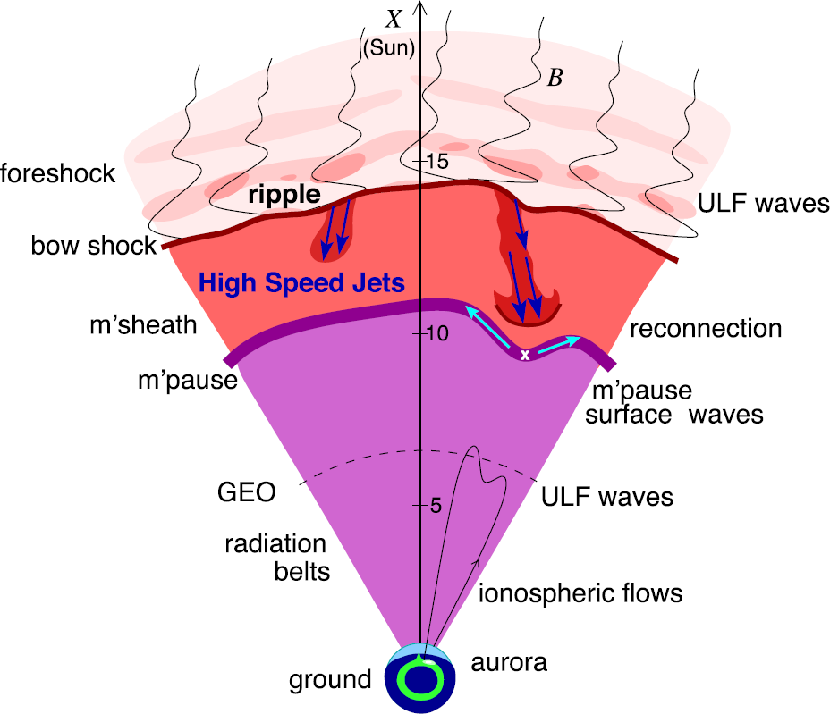
Introduction – Magnetosheath Jets
Plaschke F et al. (2018); sketch by H. Hietala | Space Sci. Rev

Slide 3
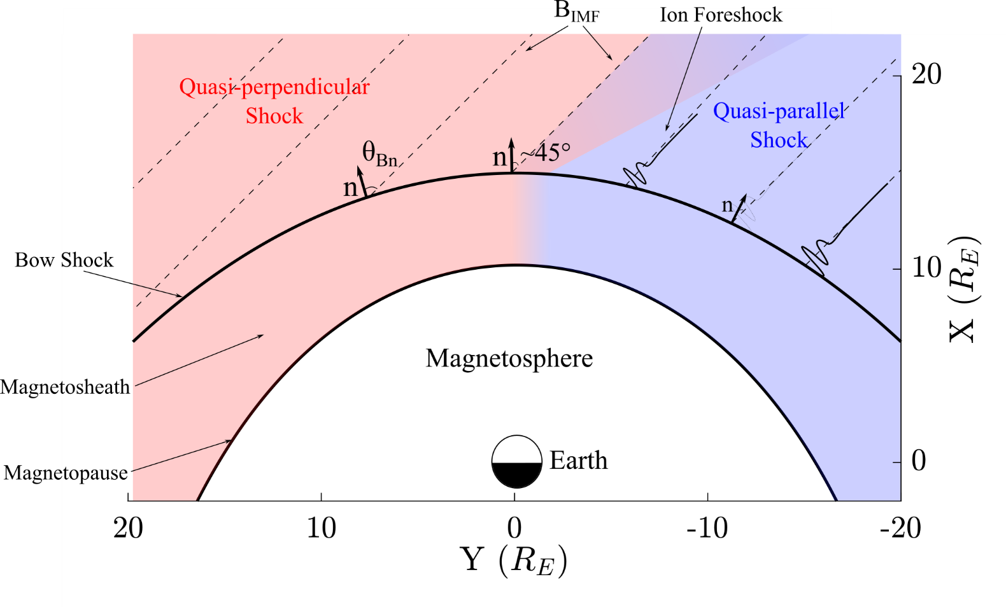
Jets behind Qpar and Qperp bow shock
Raptis et. al. (2020) | Front. Astron. Space Sci

Slide 4
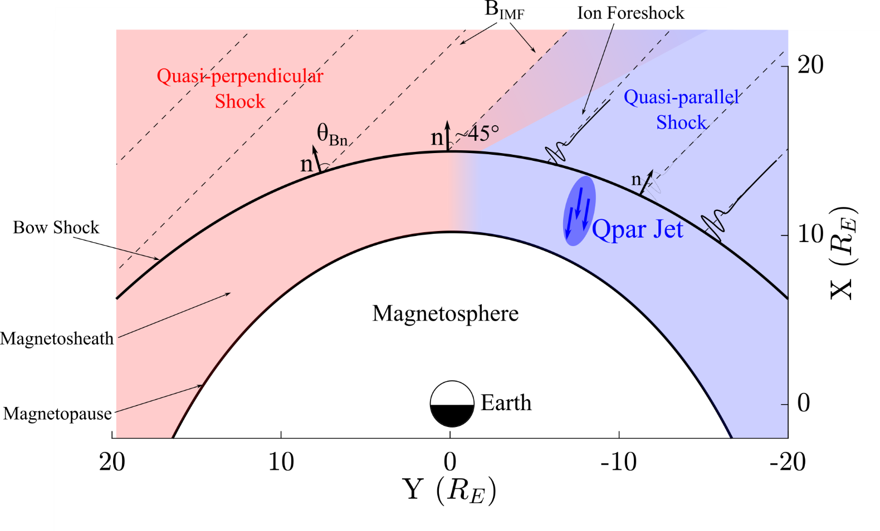
Jets behind Qpar and Qperp bow shock
Raptis et. al. (2020) | Front. Astron. Space Sci
Qpar Jet
Raptis, et. al. (2020) | JGR - Under Review

Slide 5
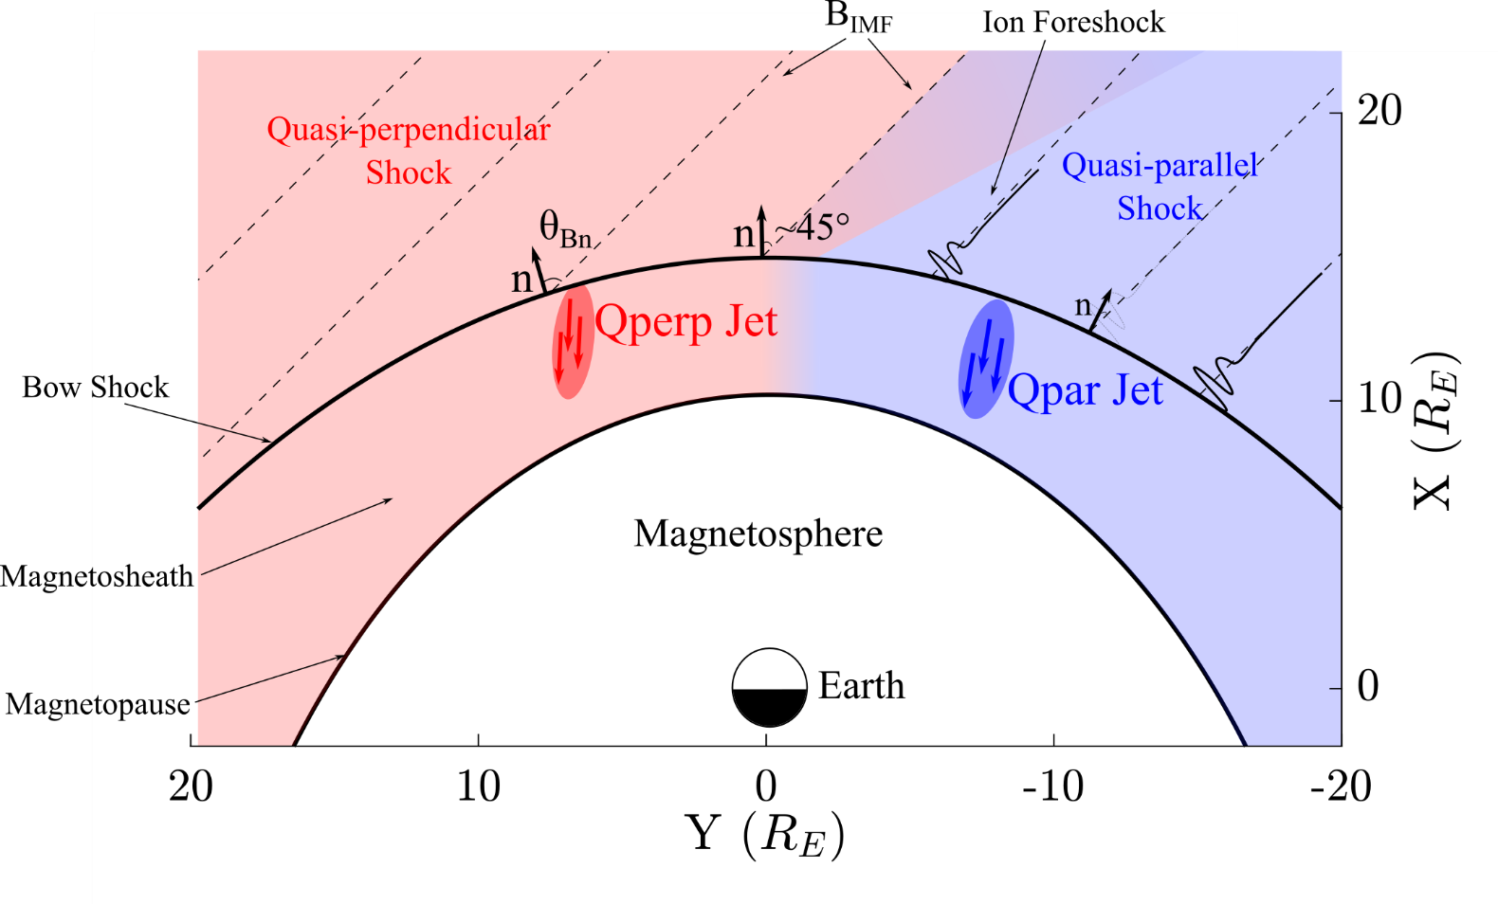
Jets behind Qpar and Qperp bow shock
Raptis et. al. (2020) | Front. Astron. Space Sci
Qpar Jet
Qperp Jet
Raptis, et. al. (2020) | JGR - Under Review

Slide 6
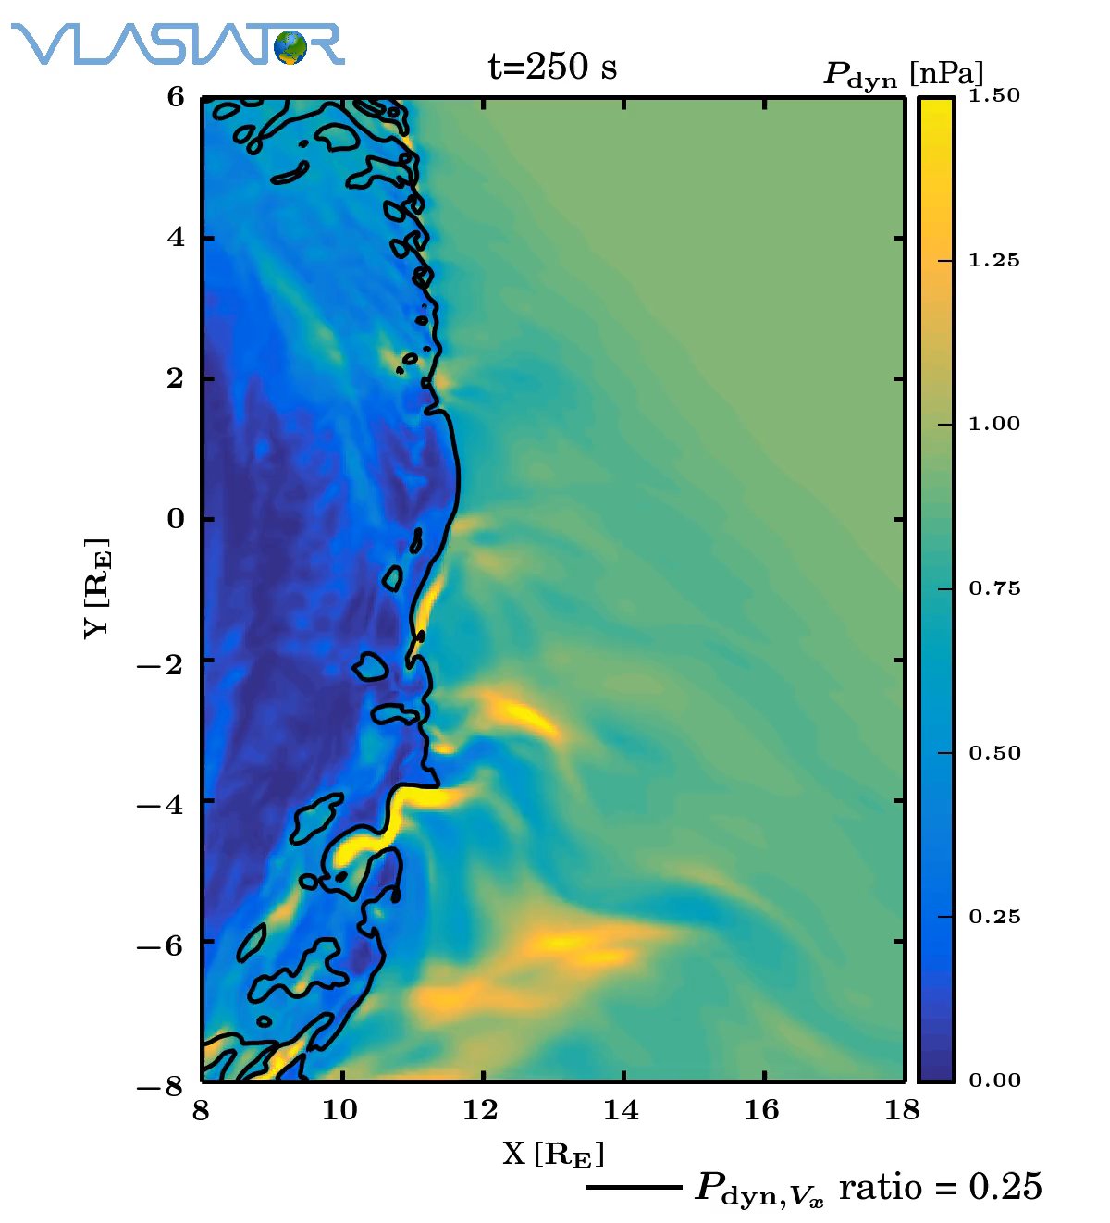
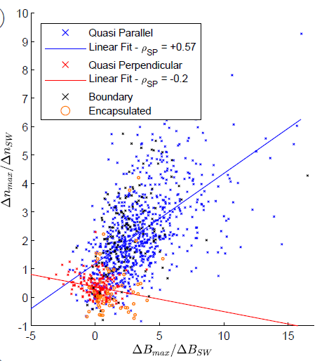
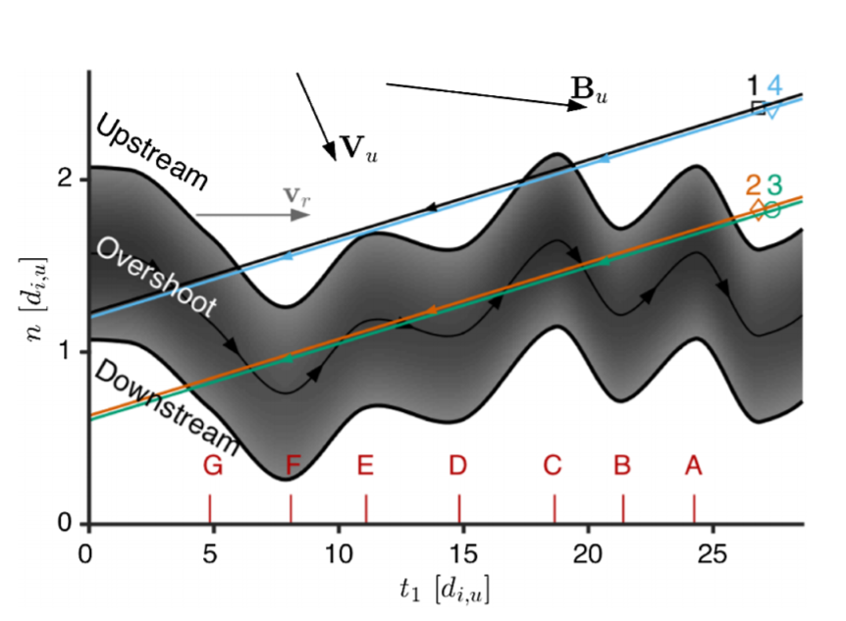
Future – Approaching the bow shock
How are Jets created?
Reconnection/FTEs (Qpar/Qperp)
SLAMS penetrating bow shock (Qpar)?
Ripples (Qpar/Qperp)
…
Preisser et al. (2020) | ApJL
Karlsson et al. (2015) | JGR
Palmroth M. et al. (2018) | | Annales
Palmroth, Raptis, et. al. (2020) | Annales - Under Review
Johlander et al. (2016) | PRL
Raptis, et. al. (2020) | JGR - Under Review

Slide 7
Extras

Slide 8
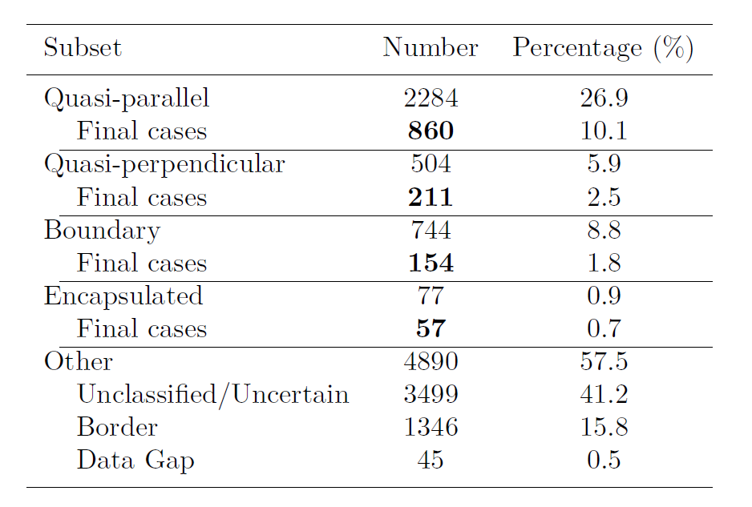
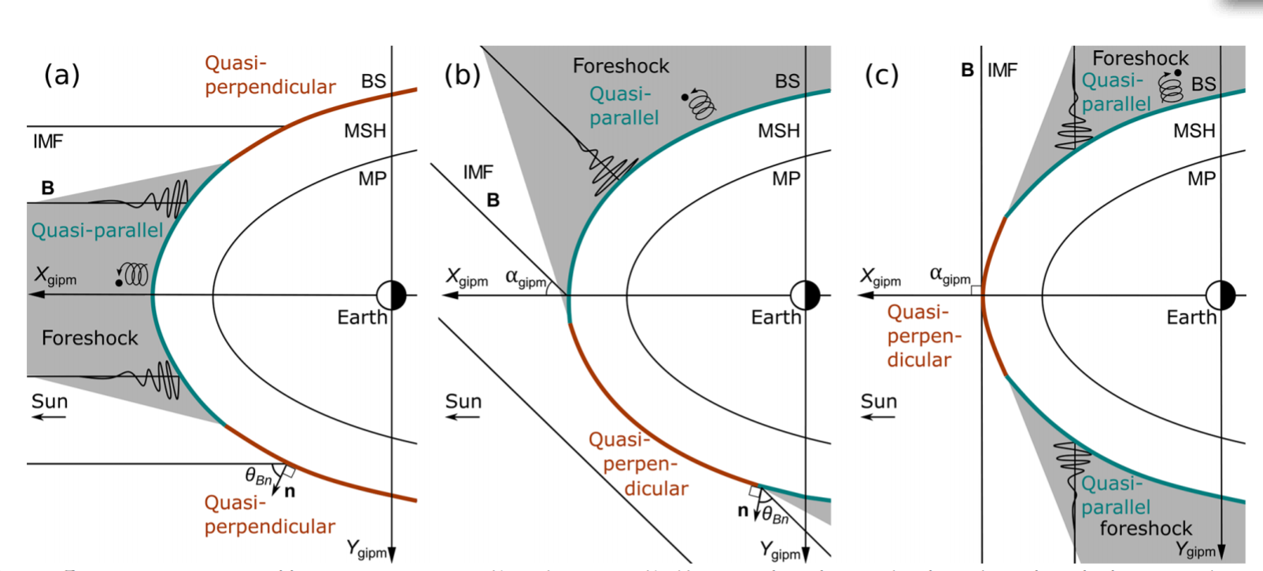
Occurrence of Qpar and Qperp
~9 times more frequently Qpar than Qperp
Different criteria/ regions but still
in agreement! ~5 times
Vuorinen .L, et. al. (2019) | angeo-37-689-2019
Raptis S., et. al. (2020) | JGR - Under Review

Slide 9
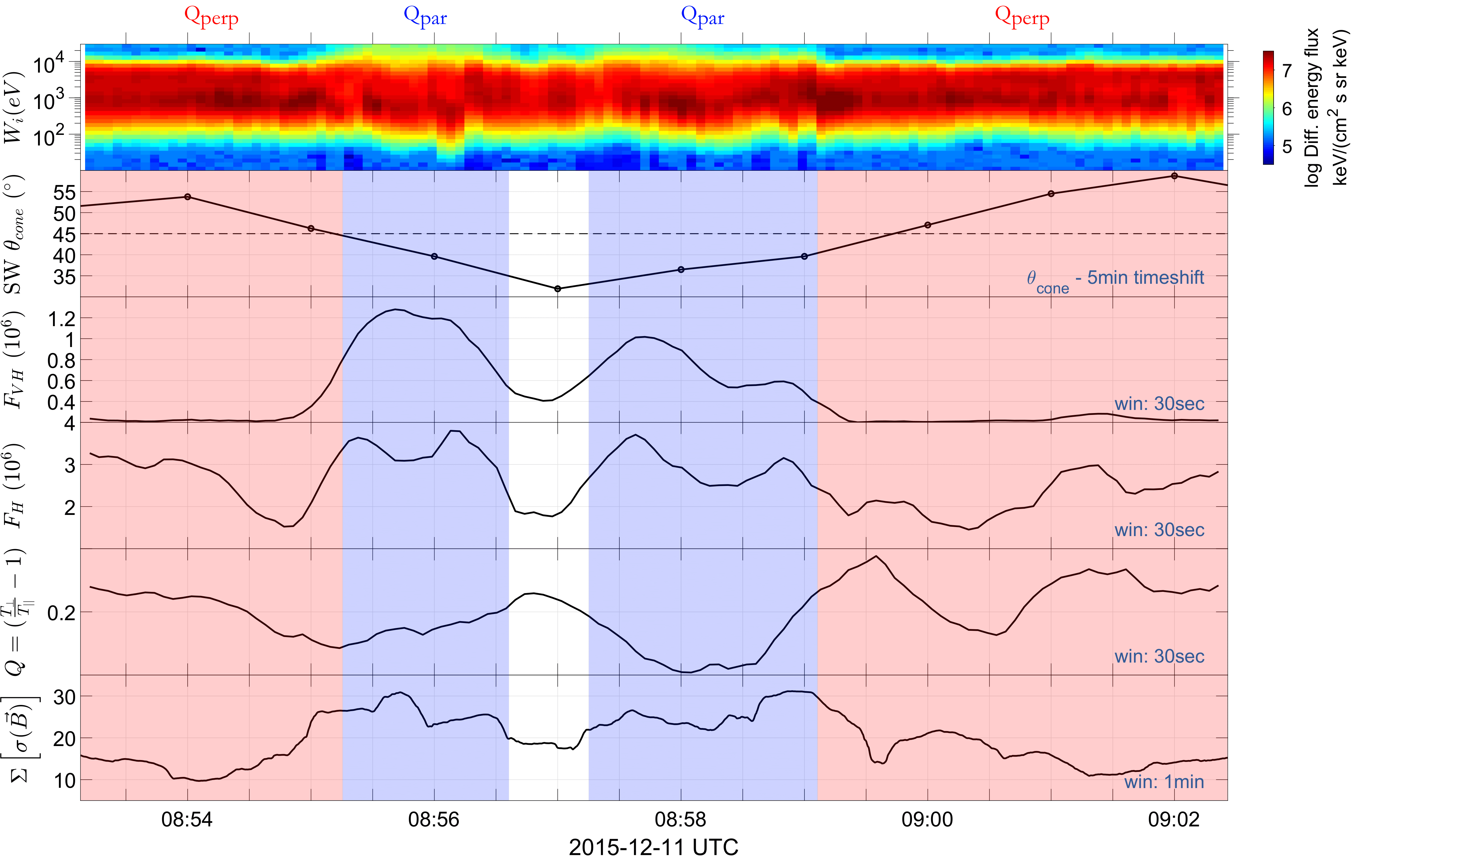
Classification Procedure in progress
Cone Angle
Very High Energy
Flux
High Energy Flux
Anisotropy
Magnetic Field Variance
Raptis, et. al. (2020) | JGR - Under Review

